Slide 1
Linear Investigation
EQ – Describe the steps for an investigation task.

Slide 2
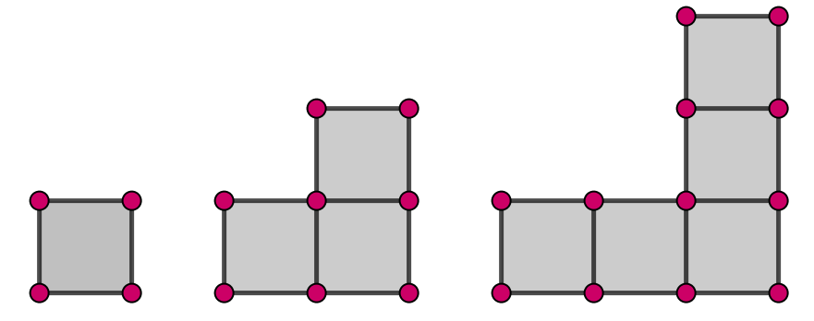
Linear Investigation EQ – Describe the steps for an investigation task
Investigate the following pattern
Notes:
Students to work in groups
Resources: Butchers paper/ pens

Slide 3
Linear Investigation EQ – Describe the steps for an investigation task
Hints
How many squares does each shape have?
What comes next?
What is the pattern?
Table of values
Can you find a rule?
Can you tell me how many squares in any of the shapes?
Investigate the following pattern
Notes:
Students to work in groups
Resources: Butchers paper/ pens

Slide 4
Linear Investigation EQ – Describe the steps for an investigation task
Process
Describe in words the pattern. What comes next? Draw and identify the number of squares/area/perimeter/points matchsticks/lines. (There is more than one pattern)
Predict and check
Create a table of values
Describe the pattern in the table
Describe the rule using words and symbols.
Check your rule works
How could you use your rule? Example
Investigate the following pattern - Solution

Slide 5
Linear Investigation 2
EQ – Describe the steps for an investigation task.

Slide 6
Learning Objectives
To be identify patterns.
To understand the investigative process
To be able to explain reasoning and justify results

Slide 7
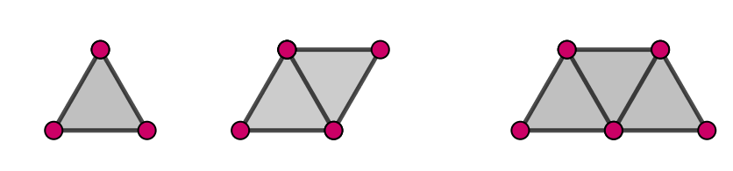
Linear Investigation 2 EQ – Describe the steps for an investigation task
Investigate the following pattern

Slide 8
Linear Investigation 2 EQ – Describe the steps for an investigation task
Investigate the following pattern
Hints
How many triangles does each shape have?
What comes next?
What is the pattern?
Table of values
Can you find a rule?
Can you tell me how many triangle in any of the shapes?

